Slide 1
Please use the 2° slide as template and delete these instructions
name your file firstauthor_title.pptx where first author is the shortened (max 10 char) name of the first author and title is the shortened (max 10 char.) title
do not change the font or the size of the text: remember, this should be viewable on a screen or on a tablet
you are free to change the background colour but please stick to the color theme
add the logo of your institution to the upper left but leave the meeting logo on the upper right
you can modify the sections if you want but you should provide at least some detail of the background and methods
use a minimum of references cited as Parente et al., 2025, 10.3390/foods13111689 and add them at the bottom center or right
add any acknowledgements at the bottom right
use pictures with at least 150 ppi resolution
by submitting the abstract you are agreeing to a https://creativecommons.org/licenses/by-nc-sa/4.0/deed.en agreement; this is necessary for uploading the file on our website so that whoever is attending in remote can see it; therefore do not use any information which is sensitive or you want to keep private

Slide 2


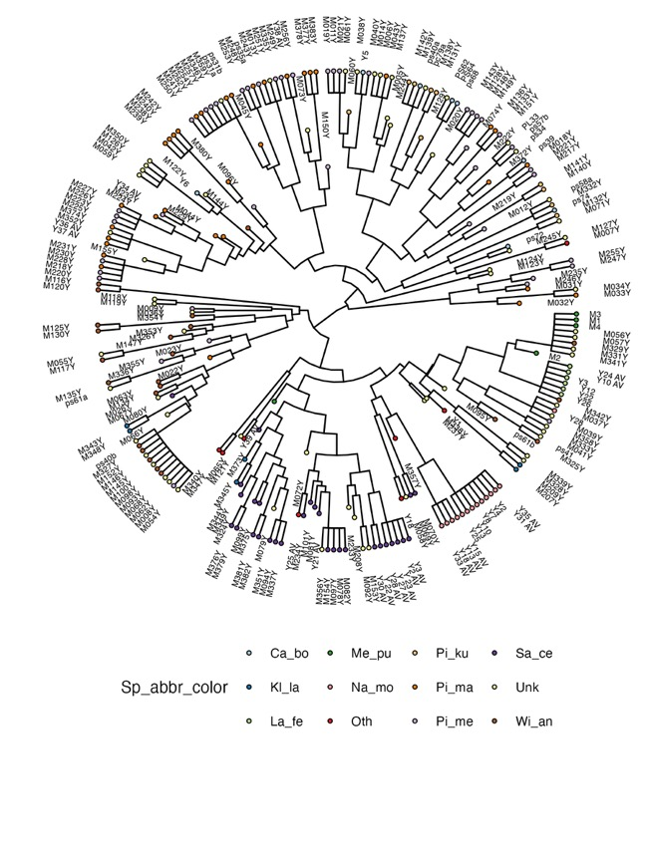
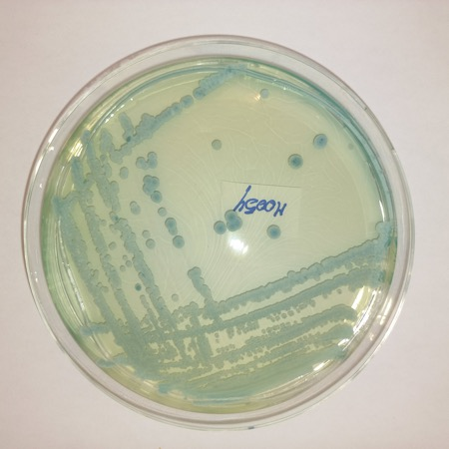
Culturable yeasts in table olives: the METAolive collection
Pietrafesa, R. (1)*, Ricciardi, A. (1), De Vivo, A. (2), Labella, M. G. (1), Parente, E. (1)
(1) Dept. of Agricultural, Forestry, Food and Environmental Sciences, University of Basilicata, Potenza, Italy (2) Dept. of Agriculture, University of Naples “Federico II”, Portici, Italy - * corresponding author: rocchina.pietrafesa@unibas.it
Background
At vero eos et accusamus et iusto odio dignissimos ducimus qui blanditiis praesentium voluptatum deleniti atque corrupti quos dolores et quas molestias excepturi sint occaecati cupiditate non provident, similique sunt in culpa qui officia deserunt mollitia animi, id est laborum et dolorum fuga. Et harum quidem rerum facilis est et expedita distinctio. Nam libero tempore, cum soluta nobis est eligendi optio cumque nihil impedit quo minus id quod maxime placeat facere possimus, omnis voluptas assumenda est, omnis dolor repellendus.
Results
Itaque earum rerum hic tenetur a sapiente delectus, ut aut reiciendis voluptatibus maiores alias consequatur aut perferendis doloribus asperiores repellat. At vero eos et accusamus et iusto odio dignissimos ducimus qui blanditiis praesentium voluptatum deleniti atque corrupti quos dolores et quas molestias excepturi sint occaecati cupiditate non provident, similique sunt in culpa qui officia deserunt mollitia animi, id est laborum et dolorum fuga.
Fig x. At vero eos et accusamus et iusto odio dignissimos ducimus qui blanditiis praesentium voluptatum deleniti
Methods
Et harum quidem rerum facilis est et expedita distinctio. Nam libero tempore, cum soluta nobis est eligendi optio cumque nihil impedit quo minus id quod maxime placeat facere possimus, omnis voluptas assumenda est, omnis dolor repellendus.
Conclusions
Temporibus autem quibusdam et aut officiis debitis aut rerum necessitatibus saepe eveniet ut et voluptates repudiandae sint et molestiae non recusandae.
Fig x. Qui blanditiis praesentium voluptatum
Advances in the microbiology of table olives – Matera 1-2/9/2025

